Slide 1
CS 3104 – OPERATING SYSTEMS
Chapter 15: File-System Internals

Slide 2
File-System Internals
File Systems
File-System Mounting
Partitions and Mounting
File Sharing
Virtual File Systems
Remote File Systems
Consistency Semantics
NFS

Slide 3
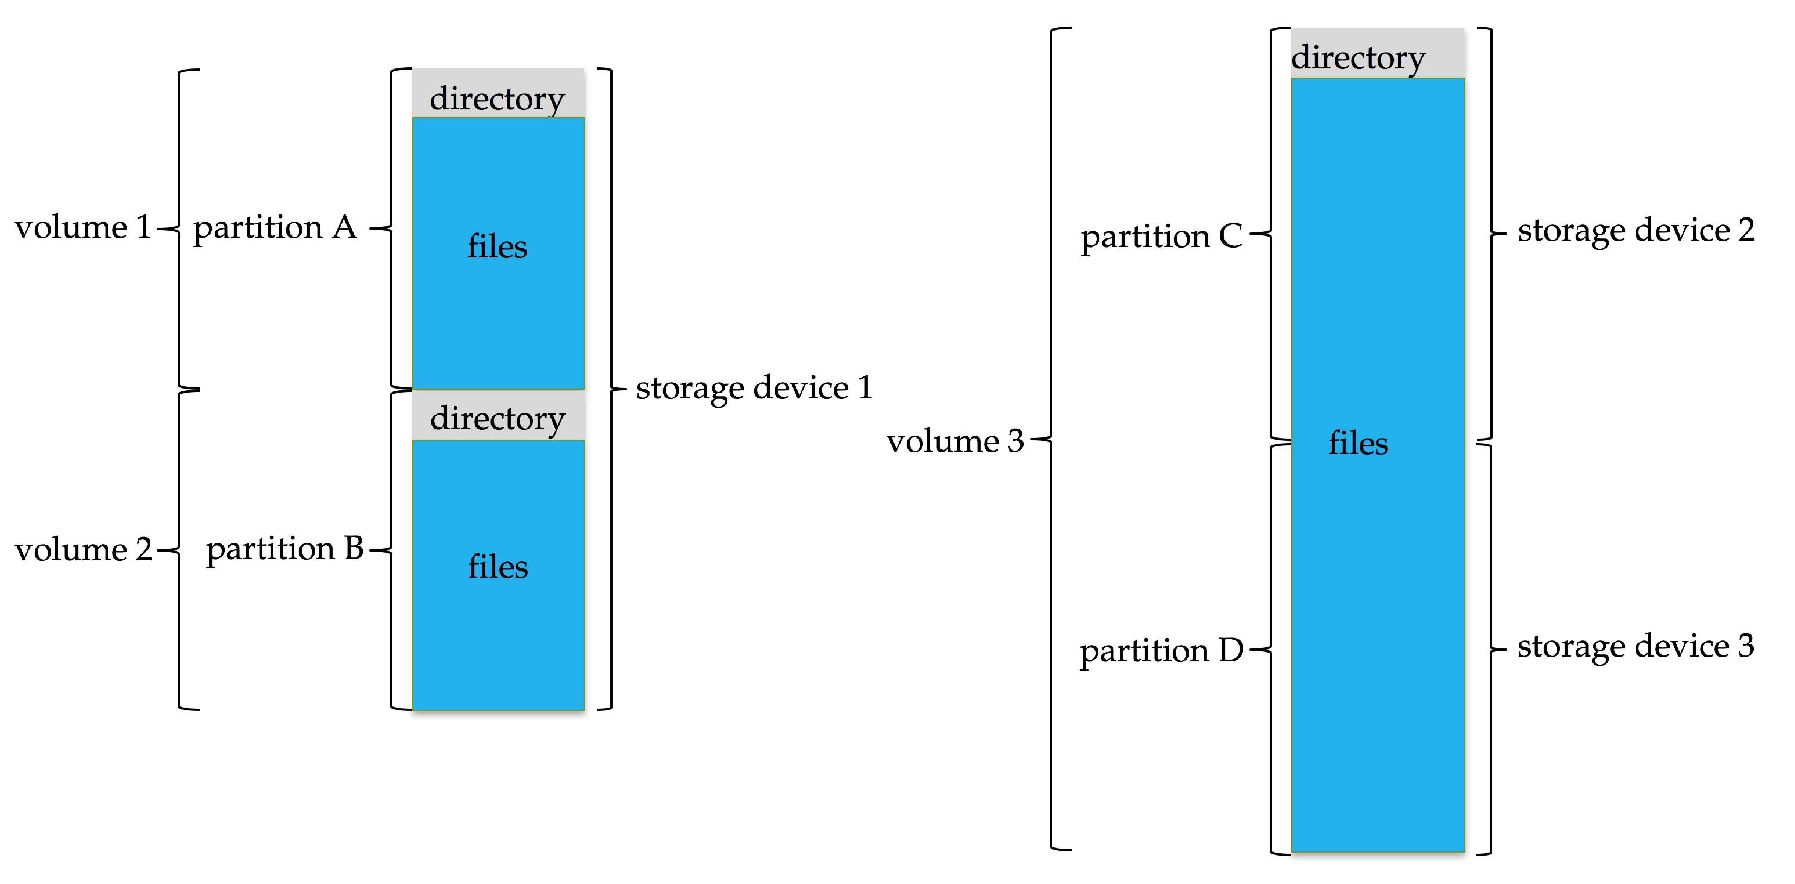
File Systems
Typical storage device organization
General-purpose computers can have multiple storage devices (to store files)
Devices can be sliced into partitions, which hold volumes
Volumes can span multiple partitions
Each volume usually formatted into a file system
# of file systems varies, typically dozens available to choose from

Slide 4
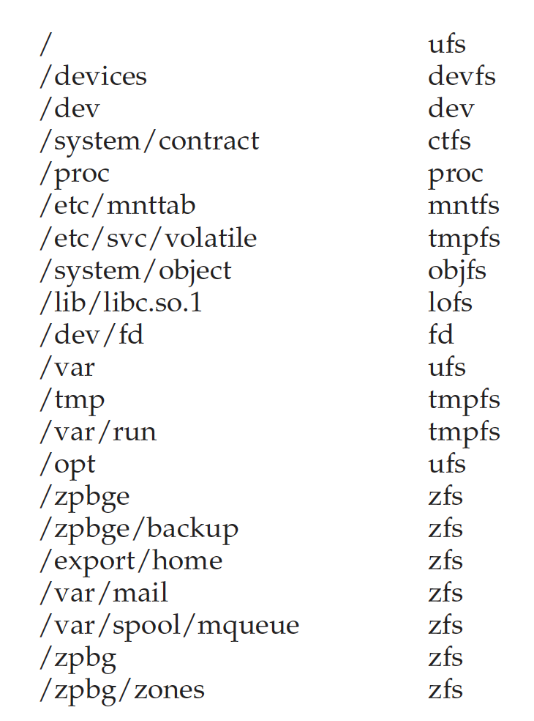
File Systems
Example Mount Points and File Systems: Solaris

Slide 5
File-System Mounting
A file system must be mounted before it can be available to processes on the system
The directory structure may be built out of multiple file-system-containing volumes
must be mounted to make them available within the file-system name space.
Mount procedure is straightforward
OS is given the name of the device and the mount point
Mount point: the location within the file structure where the file system is to be attached
Typically, a mount point is an empty directory

Slide 6
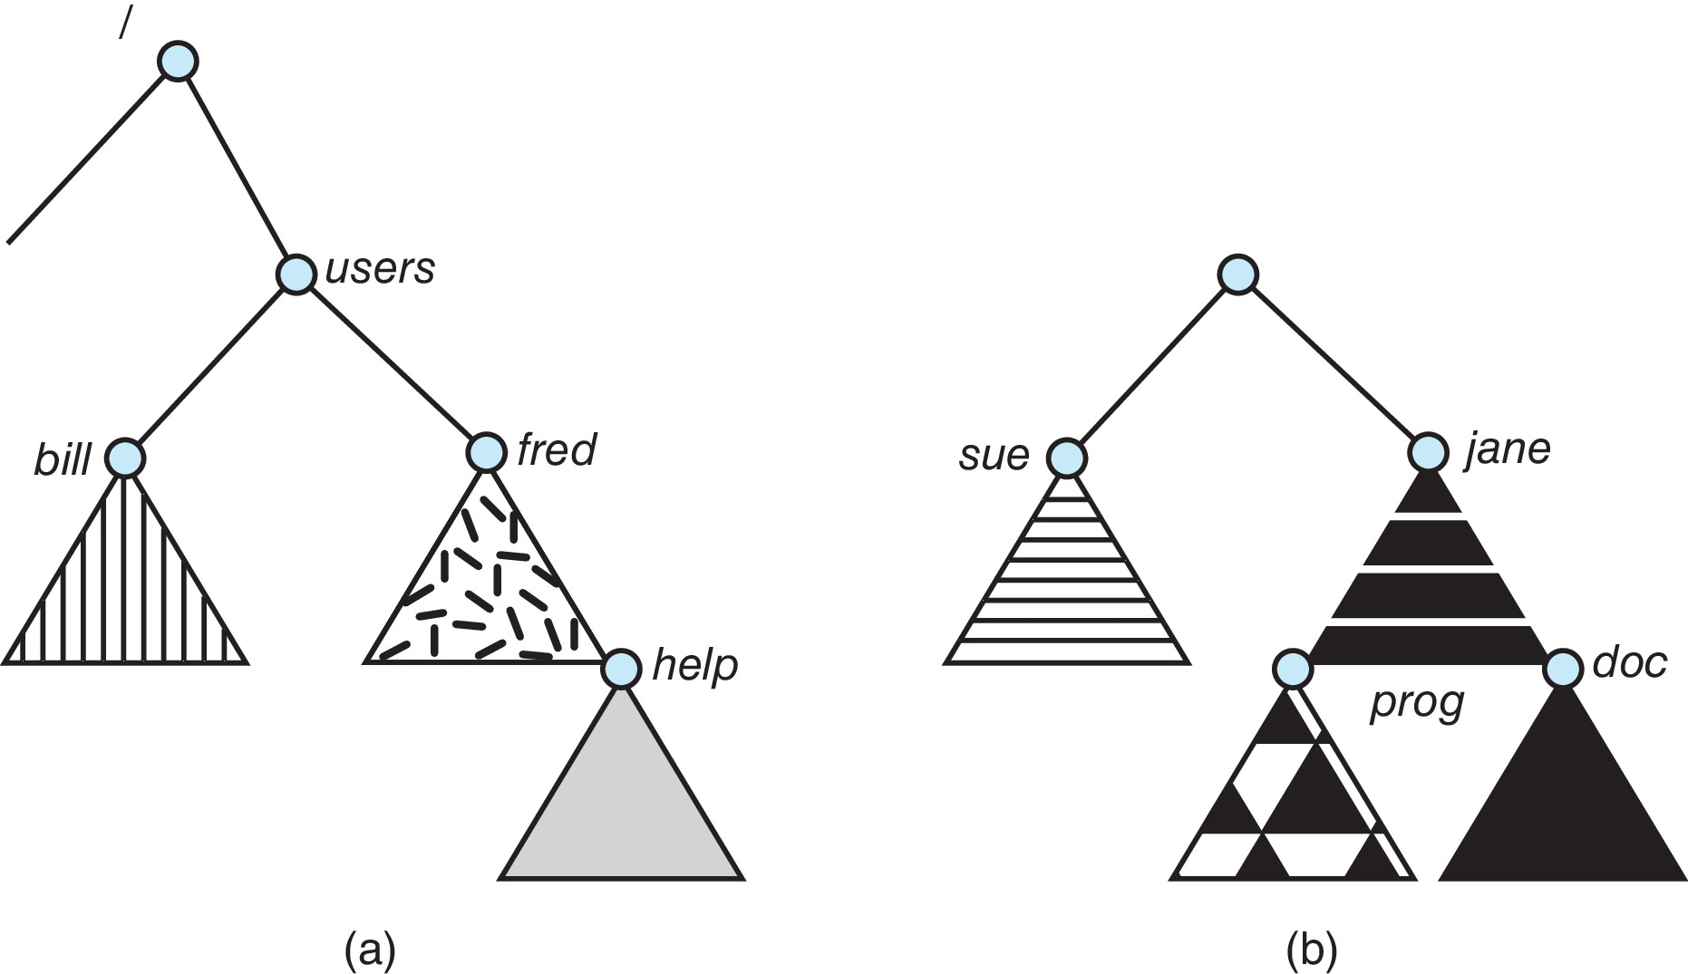
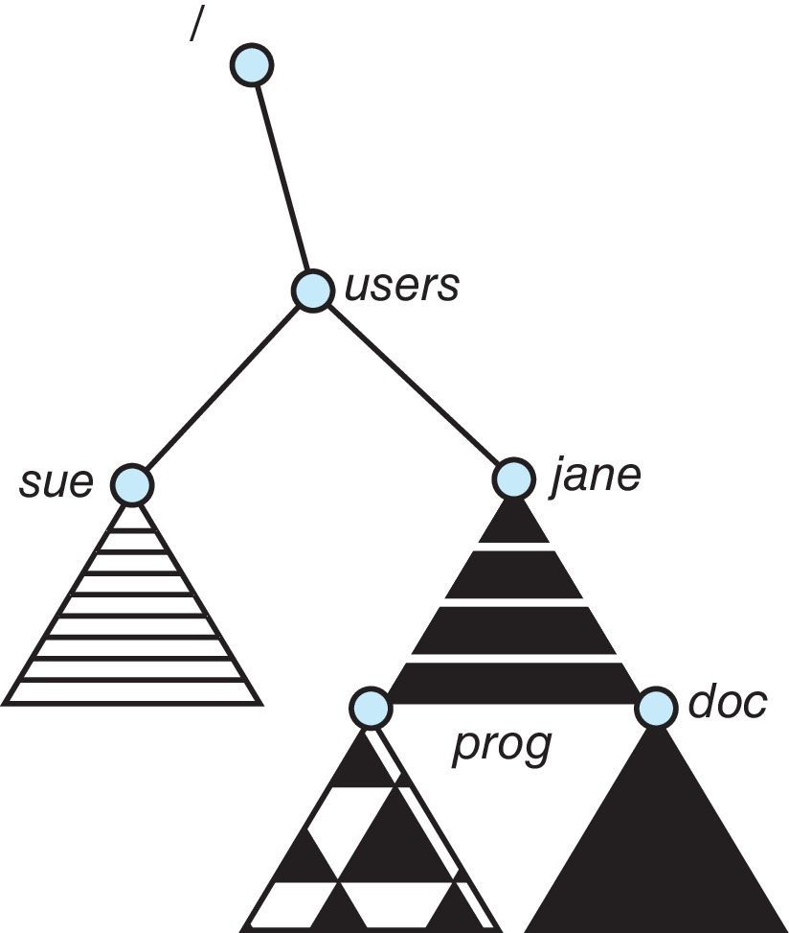
File-System Mounting
File Mounting Illustrations
(a) Unix-like file system directory tree (an existing file system)
(b) Unmounted file system (an unmounted volume residing on /device/dsk)
After mounting (b) into the existing directory tree
Volume mounted at /users

Slide 7
Partitions and Mounting
Partition can be a volume containing a file system (“cooked”) or raw – just a sequence of blocks with no file system
Boot block can point to boot volume or boot loader set of blocks that contain enough code to know how to load the kernel from the file system
Or a boot management program for multi-OS booting
Root partition contains the OS, other partitions can hold other OSes, other file systems, or be raw
Mounted at boot time
Other partitions can mount automatically or manually on mount points (location at which they can be accessed)
At mount time, file system consistency checked
Is all metadata correct?
If not, fix it, try again
If yes, add to mount table, allow access

Slide 8
File Sharing
Allows multiple users / systems access to the same files
Permissions / protection must be implement and accurate
Most systems provide concepts of owner, group member
Must have a way to apply these between systems

Slide 9
Virtual File Systems
Virtual File Systems (VFS) on Unix provide an object-oriented way of implementing file systems
VFS allows the same system call interface (the API) to be used for different types of file systems
Separates file-system generic operations from implementation details
Implementation can be one of many file systems types, or network file system
Implements vnodes which hold inodes or network file details
Then dispatches operation to appropriate file system implementation routines

Slide 10
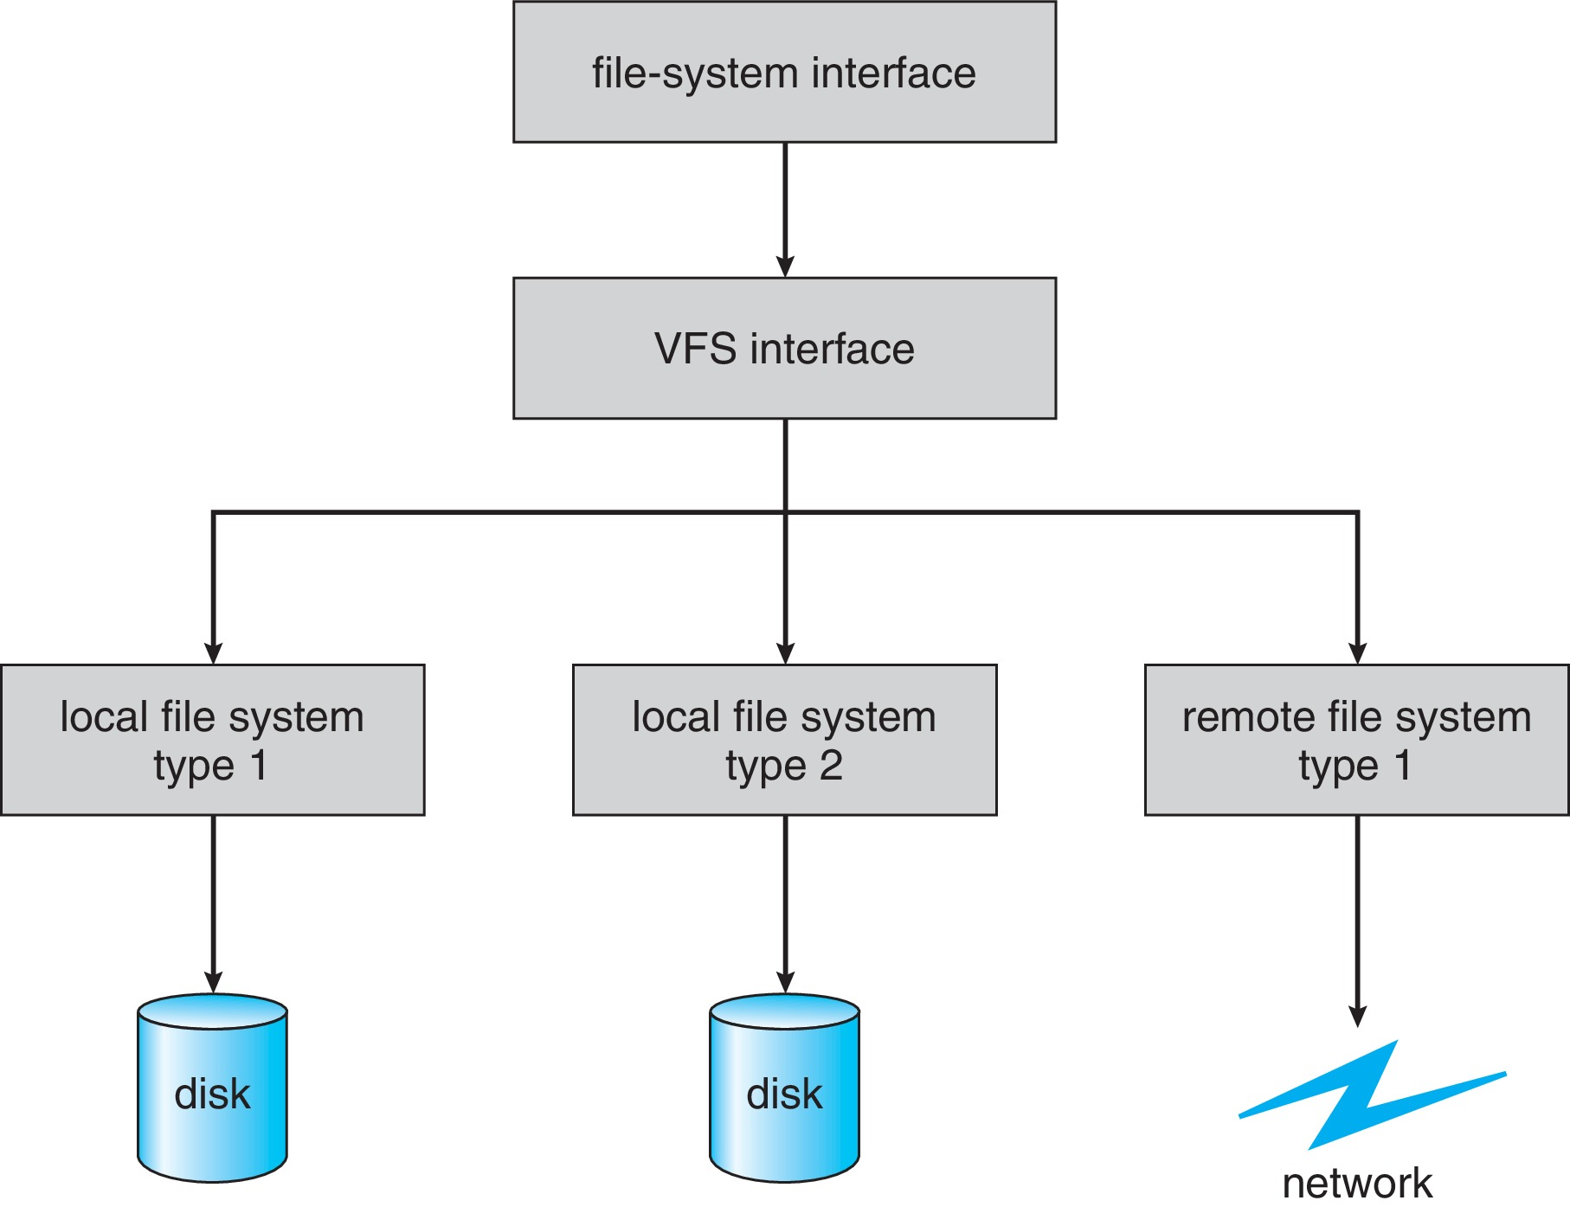
Virtual File Systems
The API is to the VFS interface, rather than any specific type of file system
Schematic View of a Virtual File System

Slide 11
Virtual File Systems
Virtual File System Implementation
For example, Linux has four object types:
inode, file, superblock, dentry
VFS defines set of operations on the objects that must be implemented
Every object has a pointer to a function table
Function table has addresses of routines to implement that function on that object
For example:
int open(. . .) — Open a file
int close(. . .) — Close an already-open file
ssize t read(. . .) — Read from a file
ssize t write(. . .) — Write to a file
int mmap(. . .) — Memory-map a file

Slide 12
Remote File Systems
Sharing of files across a network
First method involved manually sharing each file – programs like ftp
Second method uses a distributed file system (DFS)
Remote directories visible from local machine
Third method – World Wide Web
A bit of a revision to first method
Use browser to locate file/files and download /upload
Anonymous access doesn’t require authentication

Slide 13
Remote File Systems
Client-Server Model
Sharing between a server (providing access to a file system via a network protocol) and a client (using the protocol to access the remote file system)
Identifying each other via network ID can be spoofed, encryption can be performance expensive
NFS an example
User authentication info on clients and servers must match (example: UserIDs)
Remote file system mounted, file operations sent on behalf of user across network to server
Server checks permissions, file handle returned
Handle used for reads and writes until file closed

Slide 14
Remote File Systems
Distributed Information Systems
Also known as distributed naming services, provide unified access to info needed for remote computing
Domain name system (DNS) provides host-name-to-network-address translations for the Internet
Others like network information service (NIS) provide user-name, password, userID, group information
Microsoft’s common Internet file system (CIFS) network info used with user auth to create network logins that server uses to allow to deny access
Active directory distributed naming service
Kerberos - derived network authentication protocol
Industry is moving toward lightweight directory-access protocol (LDAP) as secure distributed naming mechanism

Slide 15
Remote File Systems
Failure Modes
Local file systems can fail for a variety of reasons
failure of the drive containing the file system
corruption of the directory structure or other disk-management information (collectively called metadata)
disk-controller failure
cable failure
host-adapter failure
user or system-administrator failure (causes files to be lost or entire directories or volumes to be deleted)
Remote file systems have even more failure modes
Most DFS protocols either enforce or allow delaying of file-system operations to remote hosts
Some kind of state information may be maintained on both the client and the server
NFS Version 3 takes a simple approach, implementing a stateless DFS
Industry standard NFS Version 4 makes NFS is stateful to improve its security, performance, and functionality

Slide 16
Consistency Semantics
Important criteria for evaluating file sharing-file systems
Specify how multiple users are to access shared file simultaneously
When modifications of data will be observed by other users
Directly related to process synchronization algorithms, but atomicity across a network has high overhead (see Andrew File System)
The series of accesses between file open and closed called file session
UNIX Semantics
Writes to open file immediately visible to others with file open
One mode of sharing allows users to share pointer to current I/O location in file
Single physical image, accessed exclusively, contention causes process delays
Session Semantics (Andrew file system (OpenAFS))
Writes to open file not visible during session, only at close
Can be several copies, each changed independently
Immutable-Shared-Files Semantics
Once a file is declared as shared by its creator, it cannot be modified
An immutable file has two key properties: its name may not be reused, and its contents may not be altered
Name of an immutable file signifies that the contents of the file are fixed
Implementation of these semantics in a distributed system is simple, because the sharing is disciplined (read-only)

Slide 17
NFS (Network File System)
An implementation and a specification of a software system for accessing remote files across LANs (or WANs)
The implementation originally part of SunOS operating system, now industry standard / very common
Can use unreliable datagram protocol (UDP/IP) or TCP/IP, over Ethernet or other network
Notes:
Network File System is a distributed file system protocol
Originally developed by Sun Microsystems in 1984
Allows a user on a client computer to access files over a computer network much like local storage is accessed.

Slide 18
NFS (Network File System)
Interconnected workstations viewed as a set of independent machines with independent file systems, which allows sharing among these file systems in a transparent manner
A remote directory is mounted over a local file system directory
The mounted directory looks like an integral subtree of the local file system, replacing the subtree descending from the local directory
Specification of the remote directory for the mount operation is nontransparent; the host name of the remote directory has to be provided
Files in the remote directory can then be accessed in a transparent manner
Subject to access-rights accreditation, potentially any file system (or directory within a file system), can be mounted remotely on top of any local directory

Slide 19
NFS (Network File System)
NFS is designed to operate in a heterogeneous environment of different machines, operating systems, and network architectures; the NFS specifications independent of these media
This independence is achieved through the use of RPC primitives built on top of an External Data Representation (XDR) protocol used between two implementation-independent interfaces
The NFS specification distinguishes between the services provided by a mount mechanism and the actual remote-file-access services

Slide 20
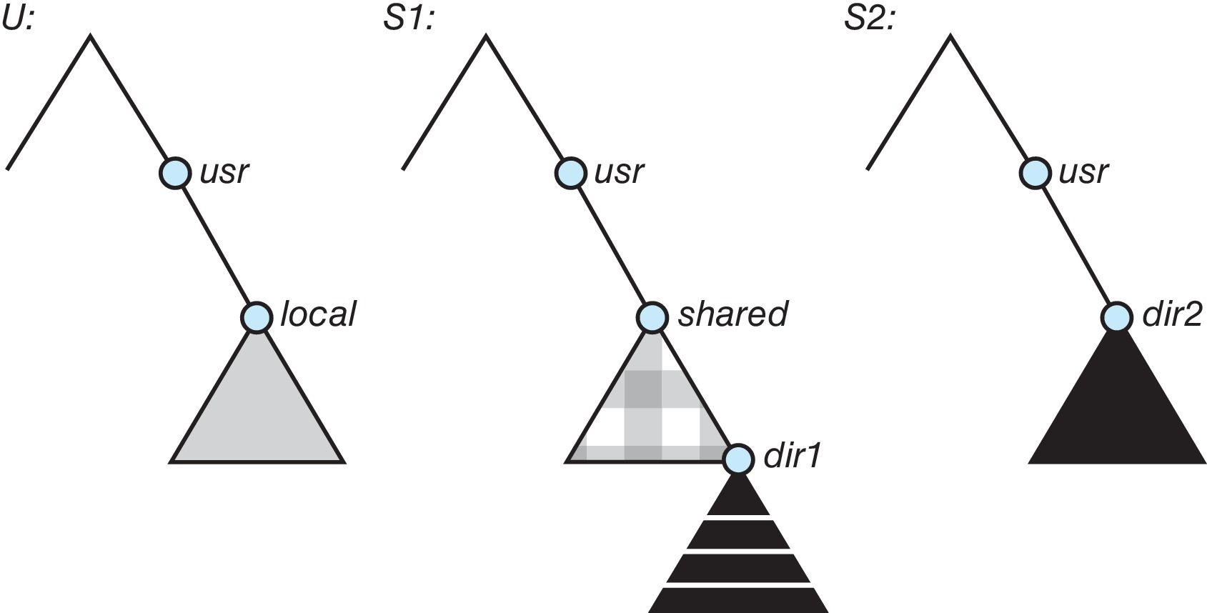
NFS (Network File System)
Three Independent File Systems

Slide 21
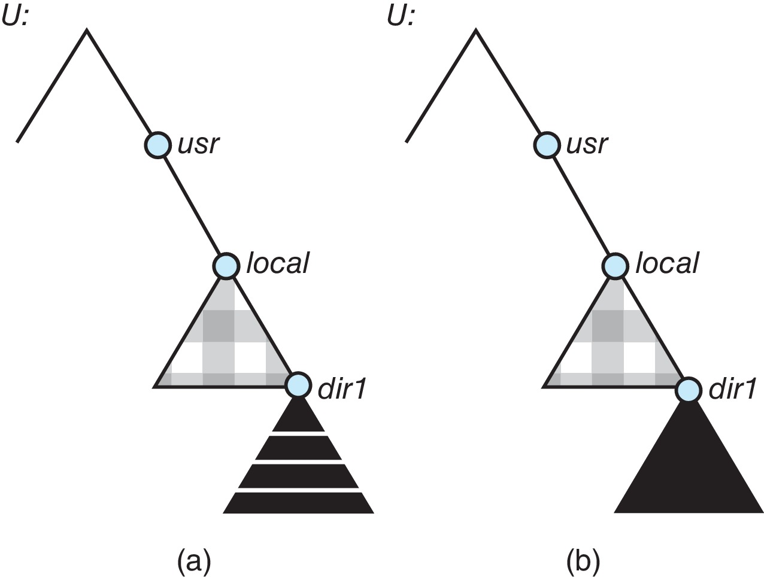
NFS (Network File System)
Mounting in NFS
Mounts
Cascading mounts

Slide 22
NFS (Network File System)
Mount Protocol
Establishes initial logical connection between server and client
Mount operation includes name of remote directory to be mounted and name of server machine storing it
Mount request is mapped to corresponding RPC and forwarded to mount server running on server machine
Export list – specifies local file systems that server exports for mounting, along with names of machines that are permitted to mount them
Following a mount request that conforms to its export list, the server returns a file handle — a key for further accesses
File handle – a file-system identifier, and an inode number to identify the mounted directory within the exported file system
The mount operation changes only the user’s view and does not affect the server side

Slide 23
NFS (Network File System)
NFS Protocol
Provides a set of remote procedure calls for remote file operations.
The procedures support the following operations:
searching for a file within a directory
reading a set of directory entries
manipulating links and directories
accessing file attributes
reading and writing files
NFS servers are stateless; each request has to provide a full set of arguments (NFS V4 is newer, less used – very different, stateful)
Modified data must be committed to the server’s disk before results are returned to the client (lose advantages of caching)
The NFS protocol does not provide concurrency-control mechanisms

Slide 24
NFS (Network File System)
Three Major Layers of NFS Architecture
UNIX file-system interface (based on the open, read, write, and close calls, and file descriptors)
Virtual File System (VFS) layer – distinguishes local files from remote ones, and local files are further distinguished according to their file-system types
The VFS activates file-system-specific operations to handle local requests according to their file-system types
Calls the NFS protocol procedures for remote requests
NFS service layer – bottom layer of the architecture
Implements the NFS protocol

Slide 25
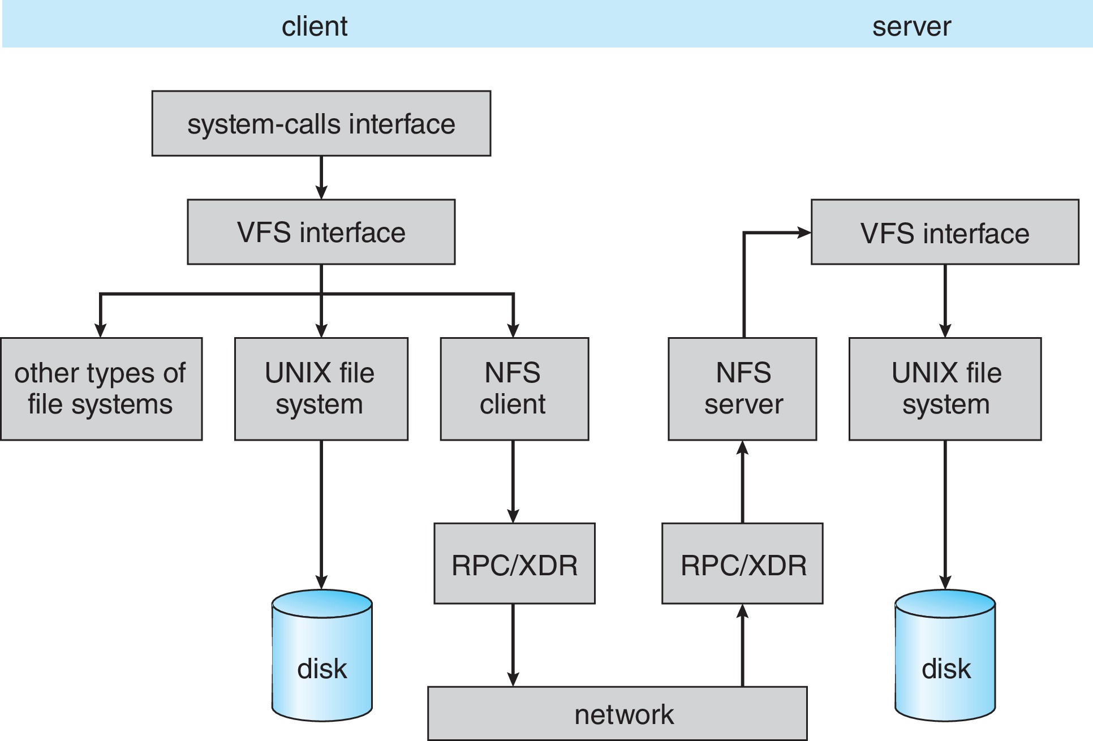
NFS (Network File System)
Schematic View of the NFS Architecture

Slide 26
NFS (Network File System)
Path-Name Translation
Performed by breaking the path into component names and performing a separate NFS lookup call for every pair of component name and directory vnode
To make lookup faster, a directory name lookup cache on the client’s side holds the vnodes for remote directory names

Slide 27
NFS (Network File System)
Remote Operations
Nearly one-to-one correspondence between regular UNIX system calls and the NFS protocol RPCs (except opening and closing files)
NFS adheres to the remote-service paradigm, but employs buffering and caching techniques for the sake of performance
File-blocks cache – when a file is opened, the kernel checks with the remote server whether to fetch or revalidate the cached attributes
Cached file blocks are used only if the corresponding cached attributes are up to date
File-attribute cache – the attribute cache is updated whenever new attributes arrive from the server
Clients do not free delayed-write blocks until the server confirms that the data have been written to disk

Slide 28
CS 3104 – OPERATING SYSTEMS
End of Chapter 15
File-System Internals

